Slide 1




Stroke Predictive Analysis of Cigarette Smokers
Final Project
CMPE 266 (F2021)
Team 5
Haasitha Pidaparthi (012669254) haasitha.pidaparthi@sjsu.edu 408-550-3836
Mohamed Shafeeq Usman
(015232529)
mohamedshafeeq.usman@sjsu.edu
669-388-1249
Nakul Gupta (015273154) nakul.gupta@sjsu.edu 650-457-4684
Ganesh Nehru (009509747) ganesh.nehru@sjsu.edu 650-785-6845

Slide 2
Introduction
Motivation
  Most of the strokes occur unexpectedly.
  Early measures can avoid a stroke. Machine learning model to predict the chances of person attaining a stroke.
Objective
  Determine if a user will encounter a stroke in the future, based on their input.
  Build machine learning model, input will be used to compare with the historical data to predict if a stroke will occur.

Slide 3
Dataset
Attributes (12): id, gender, age, hypertension, heart_disease, ever_married, work_type, Residence_type, avg_glucose_level, bmi, smoking_status, stroke
https://www.kaggle.com/lirilkumaramal/heart-stroke
https://www.kaggle.com/fedesoriano/stroke-prediction-dataset
https://bigml.com/dashboard/dataset/5e92c6d14f6bfd2dd00044a9
Kaggle: Stroke Prediction Dataset Dataset contains 5110 observations | Kaggle: Heart Stroke Dataset contains 43400 observations | BigML: Stroke Data Dataset contains 100k observations

Slide 4
Data Preprocessing
Dropping irrelevant columns. Eg: ID
Remove redundant data
Hot-label encoding of object type attributes
  gender
  ever_married
  work_type
  smoking_status
Filling missing values with kNN imputation
Handling class imbalancement using SMOTE technique

Slide 5
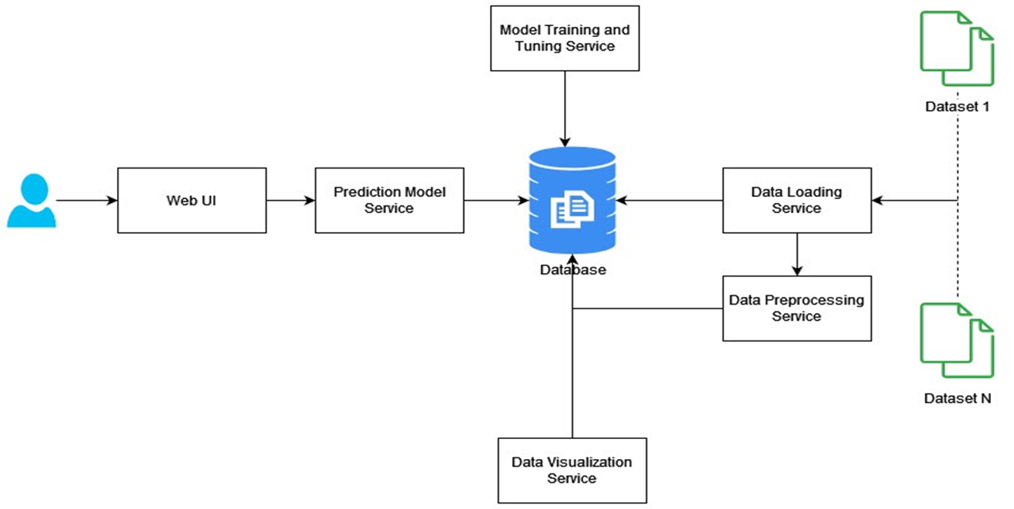
Project Design

Slide 6
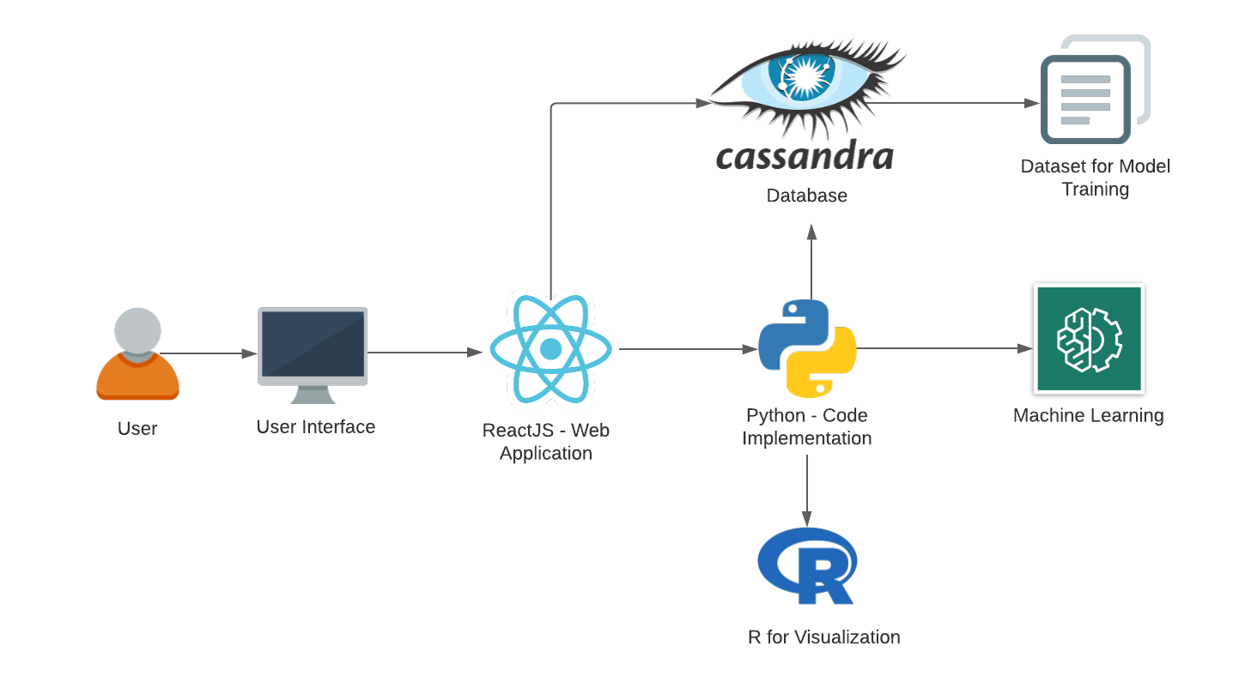
Architecture Diagram
User: Provides Input.
UI: Get the input and display the output.
Cassandra: To store the dataset.
Machine Learning: Model to predict the stoke based on the input.

Slide 7
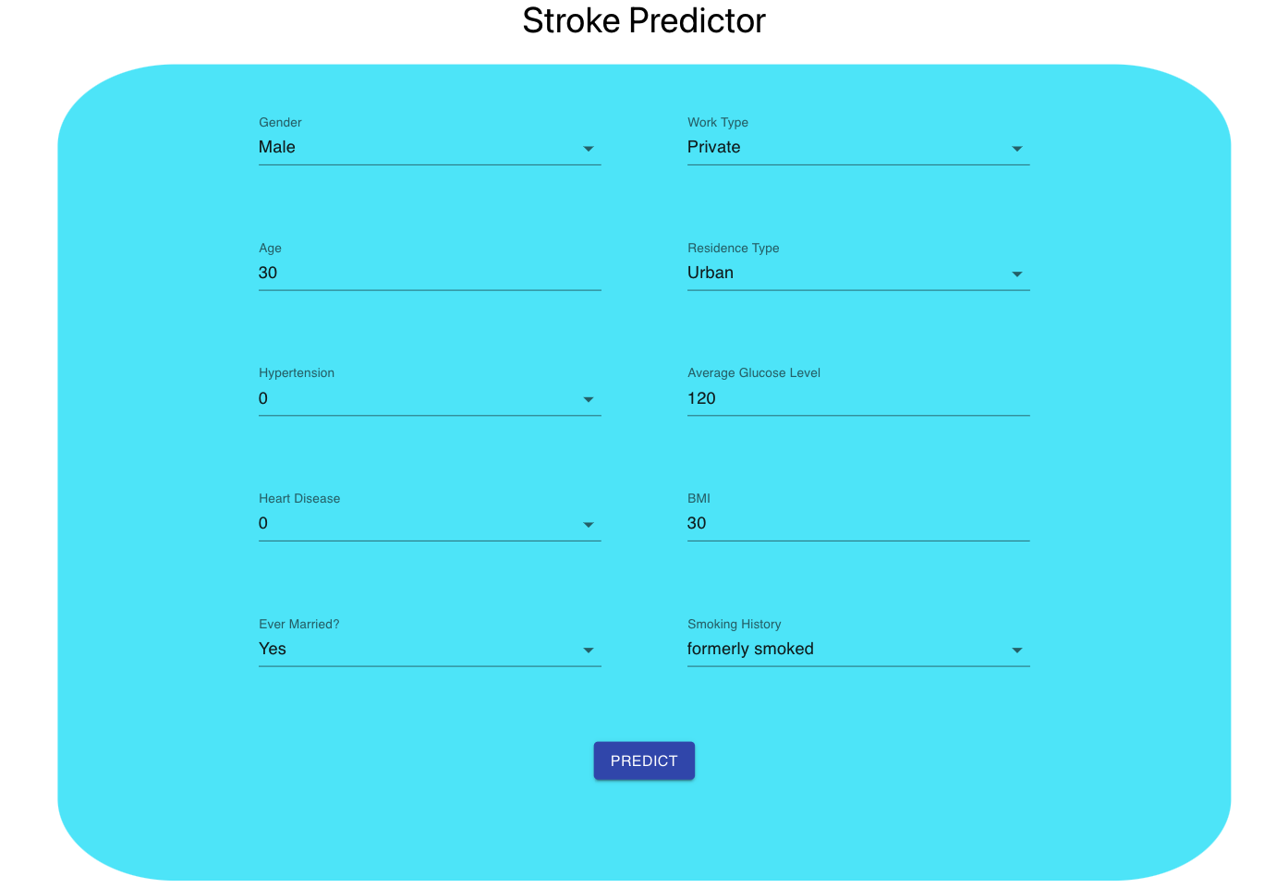
Main Screen
User’s input:
  Gender
  Work type
  Age
  Residence type
  Hypertension
  Average glucose
  Heart disease
  BMI
  Marriage status
  Smoking history

Slide 8
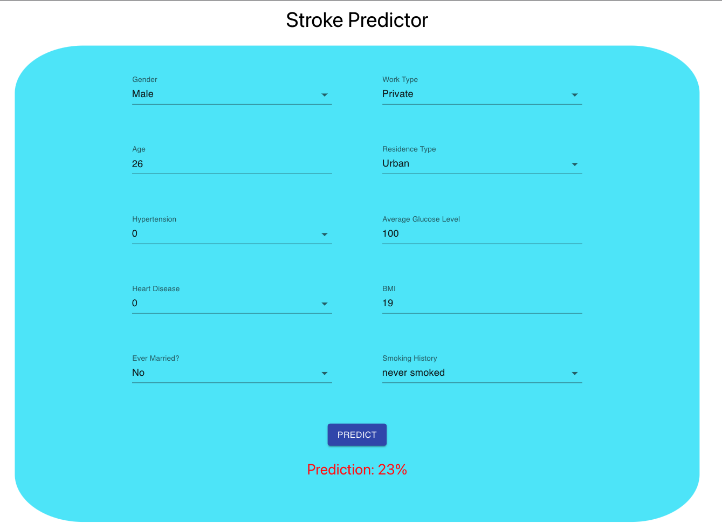
User’s Result (Positive)

Slide 9
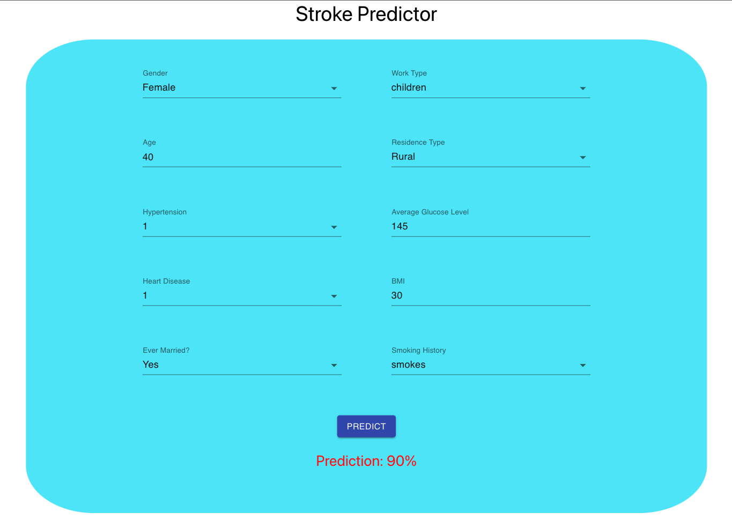
User’s Result (Negative)

Slide 10
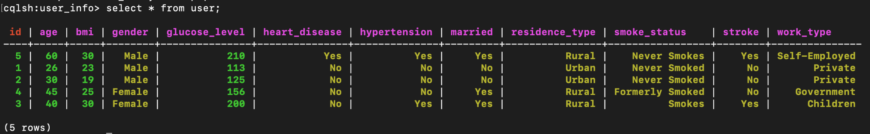
Cassandra DB

Slide 11
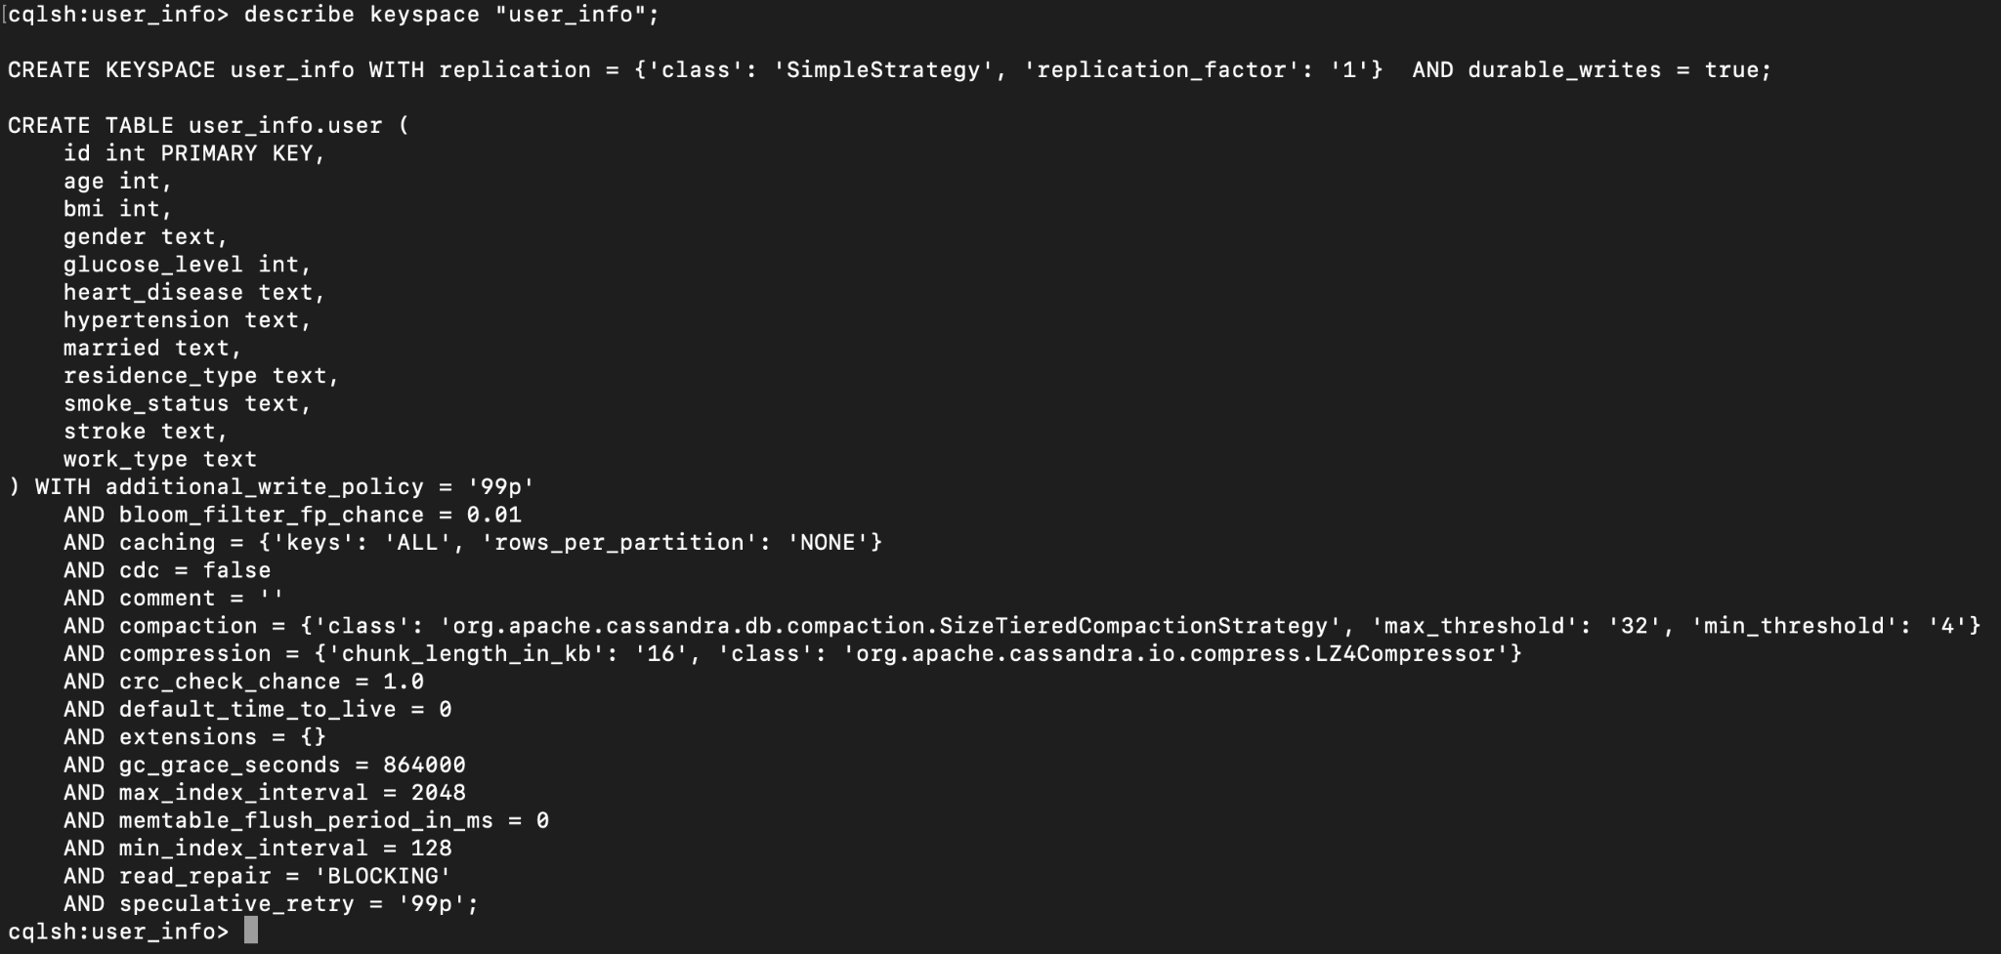
Keyspace

Slide 12
Modeling
Logistic Regression
Random Forest
k-Nearest Neighbors
XGBoost
Artificial Neural Network

Slide 13
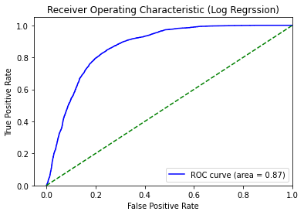
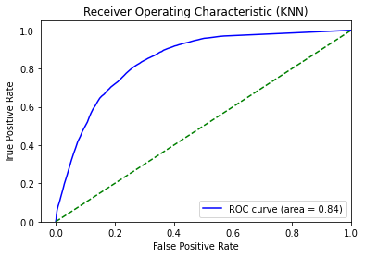
AUC-ROC Curve

Slide 14
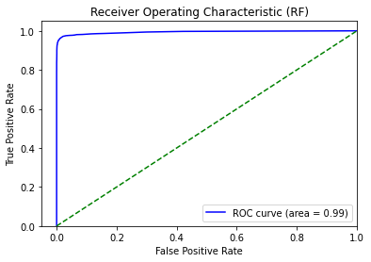
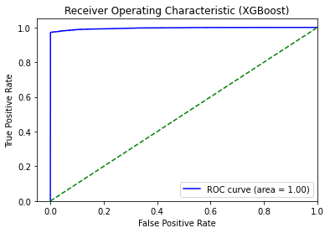
AUC-ROC Curve (Cont’d)

Slide 15
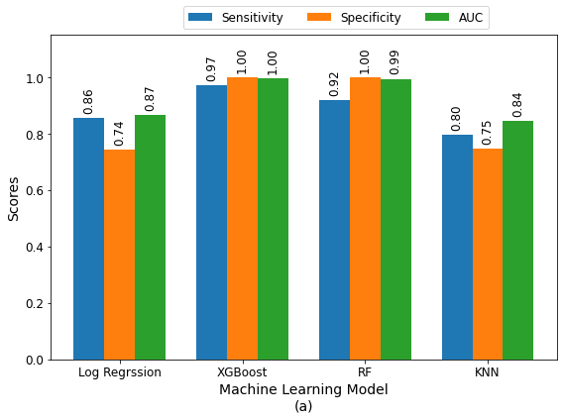
Performance Benchmark

Slide 16
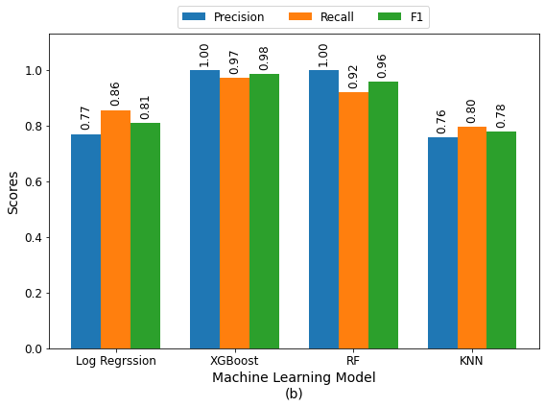
Performance Benchmark - (Cont’d)

Slide 17
Conclusion
Smoking increases the probability of having a stroke
Smoking alone is not a driving factor; age, BMI, and glucose level are important feature to determine the stroke probability
Women are prone to stroke on average at a much older age (74-79) in comparison to males which experiences strokes on average as soon as their mid 50's and 60
In the future, more data from the clinical sites can be integrated into to improve the model

